Slide 1

Data: The Raw Material
Anand Rajaraman

Slide 2
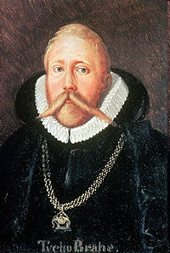
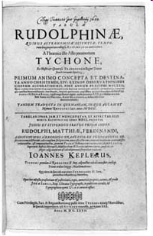
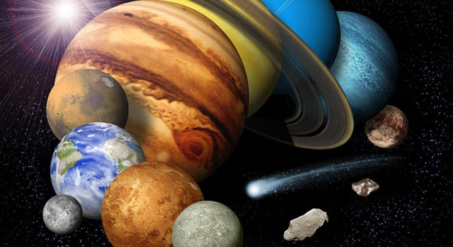
Tycho Brahe

Slide 3
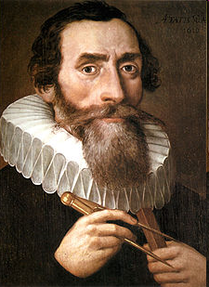
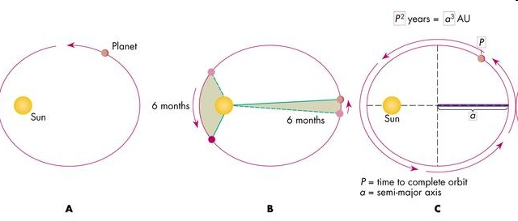
Johannes Kepler

Slide 4
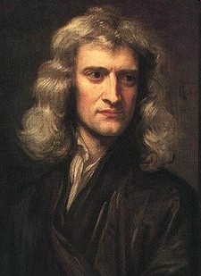
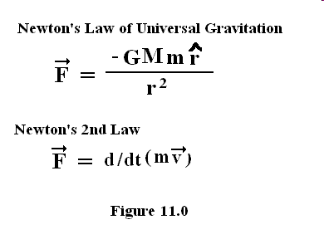
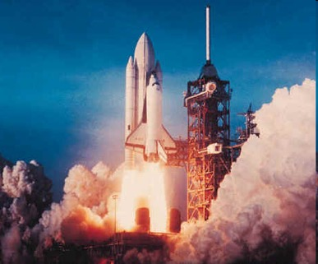
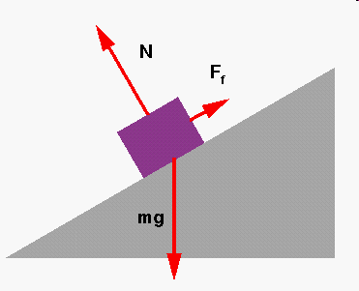
… and Isaac Newton

Slide 5
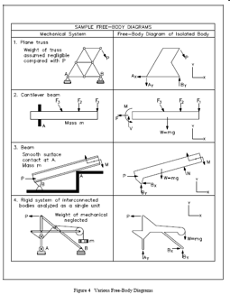

The Classical Model
F = ma
Data
Theory
Applications

Slide 6
50-fold Growth from 2010 to 2020
2014: More bits in the digital universe than stars in the physical universe
Notes:
Data Explosion: 44,000 exabytes = 44 zettabytes

Slide 7
Sources of Data
The world creates 1.7MB of data per minute per person
The Digital Universe -- IDC Report, 2014

Slide 8
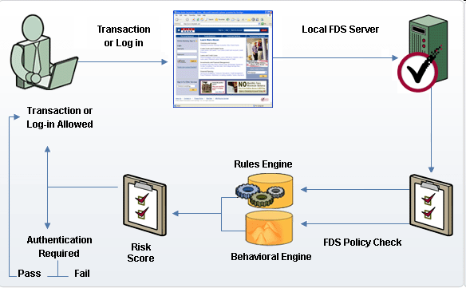
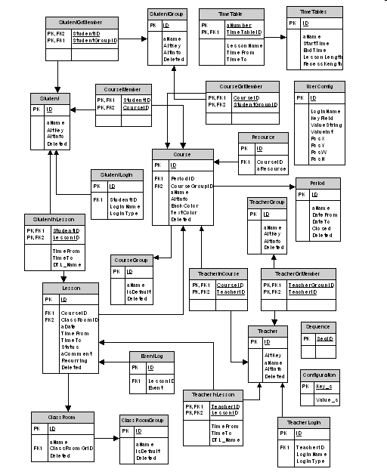
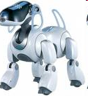
Model-based decision making
Neural Nets
Regression
Decision Trees
Model
Data
Model
Predictions

Slide 9
The Evolution of data-driven apps
From 1990 to the present day

Slide 10
Follow the Data!
Value-creation has followed the most valuable data sources
Algorithms and methods follow the data
4 overlapping generations

Slide 11
Data driven apps: The First Generation
All about leveraging private, structured data assets for competitive advantage
E.g., Sales, inventory, payroll, …

Slide 12
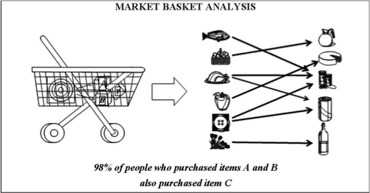
First Gen Example: Market Baskets
Find items that often appear together in baskets

Slide 13
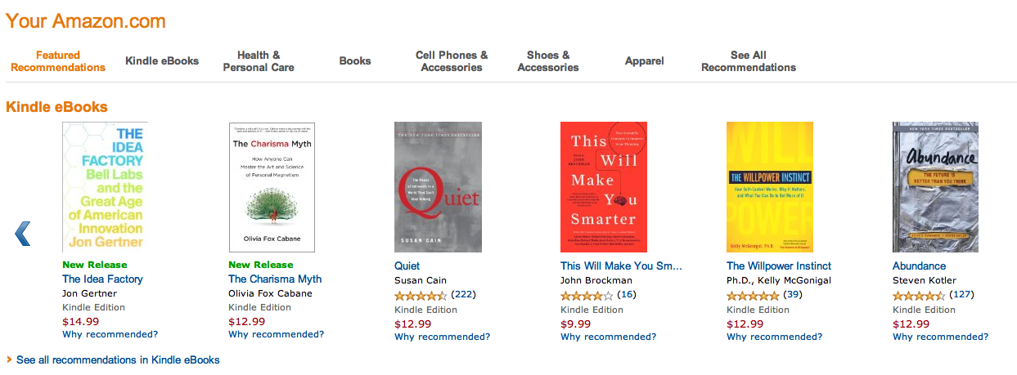
First Gen Example: Recommendations

Slide 14


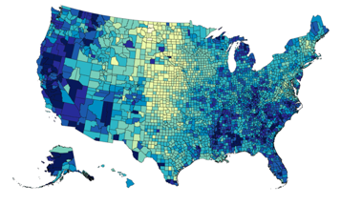
Data-driven apps: The Second Generation
Harnessing the power of public data

Slide 15
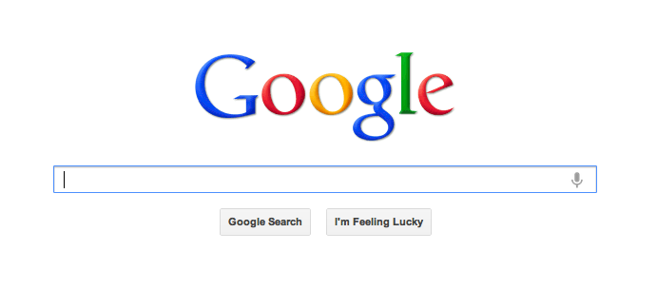
Second Gen Example

Slide 16
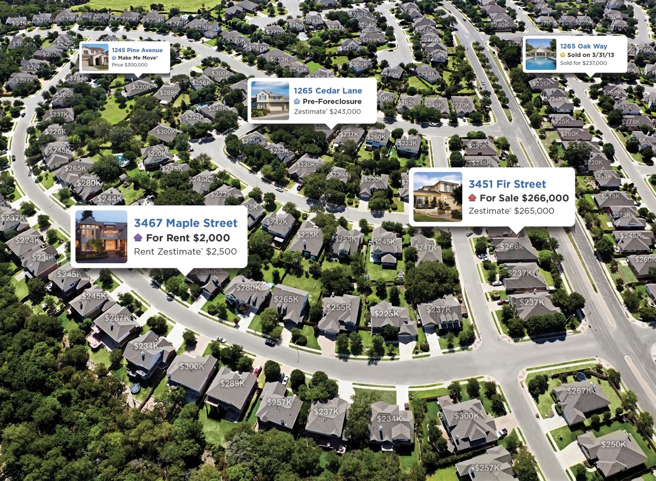
Second Gen Example: Zestimates

Slide 17
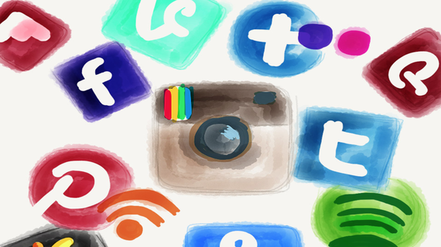
Data-Driven Apps: The Third Generation
Leveraging the power of “semi-public” Social + Mobile Data
Personal data shared in a frictionless manner with user’s consent (and sometimes without?)

Slide 18
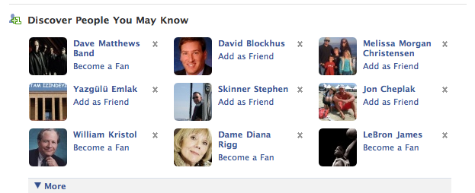
Third Gen Examples

Slide 19
The Fourth Generation: Training Data
ML becomes mission-critical
Growing need for human-labeled data to train and evaluate algorithms
Google team of 10,000 to manually label search results

Slide 20
Crowdsourcing democratizes ML

Slide 21
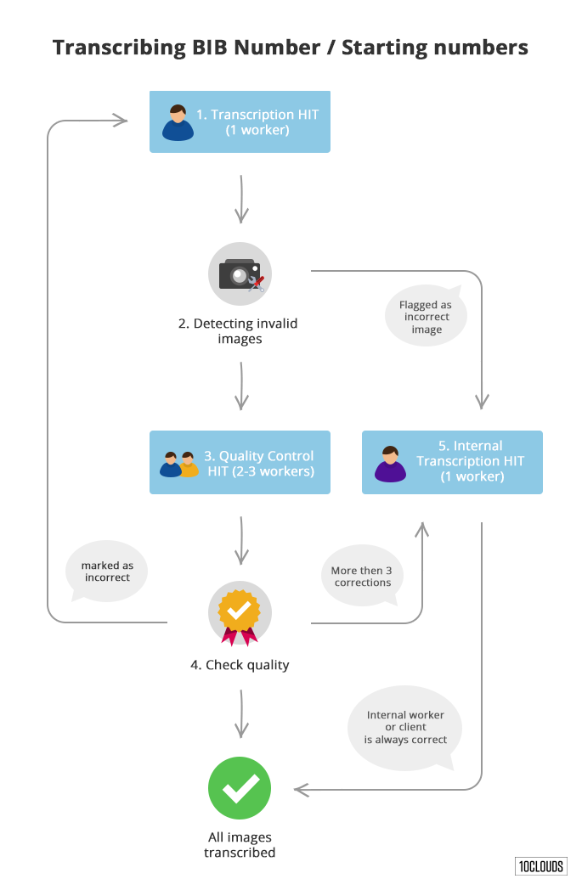
Example: Transcribing bib numbers
10Clouds Blog

Slide 22
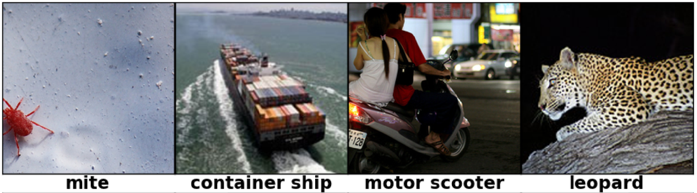
Dawn of Deep Learning
Database of over 14M labeled images
Image classification breakthrough that put Deep Learning on the map

Slide 23
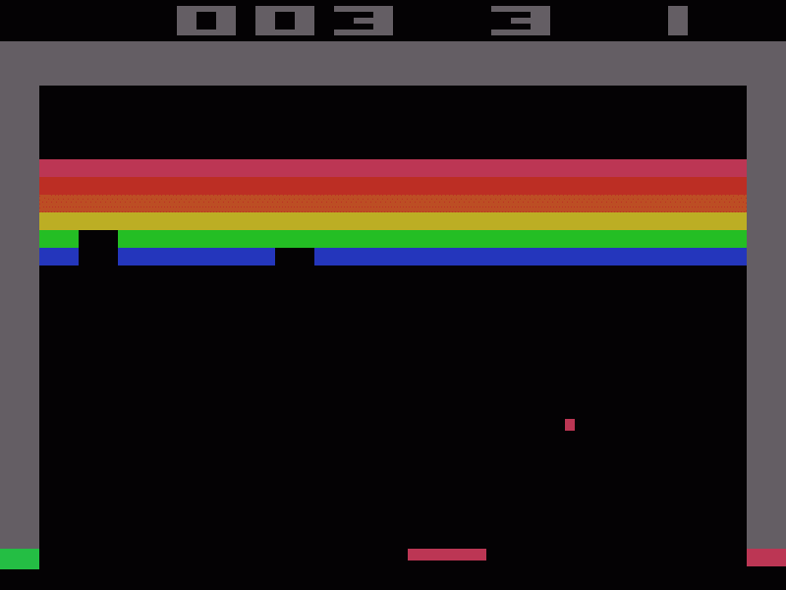
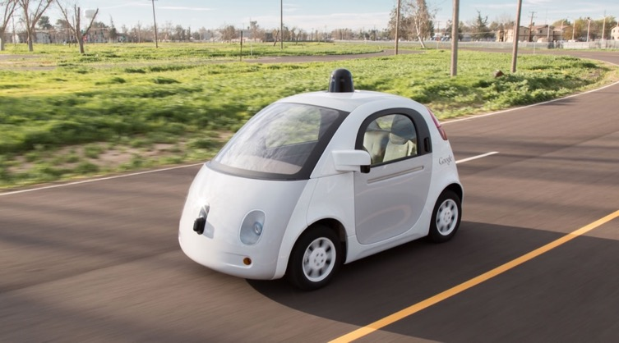
Fourth Gen Examples

Slide 24


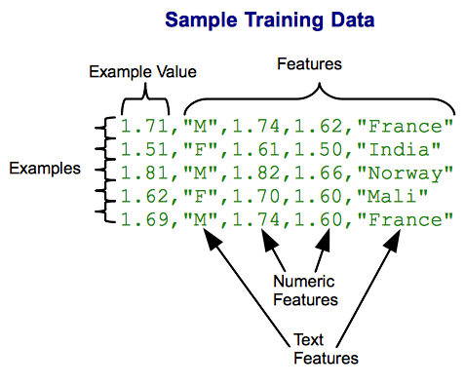
Combining data sets
+

Slide 25


Example: Google Search
Search session data
e.g., spelling correction
Labeled data from Search
Quality Raters

Slide 26
The Data Market and Data Brokers

Slide 27
Data Collection fundamentals

Slide 28
Key Concepts
Quantity
Quality
Cost
Structure
Freshness

Slide 29
Quantity
Breadth
Number of entities or observations
E.g., People, companies, stars, shopping trips,…
Ideally: comprehensive
Depth
Data gathered on each entity or observation

Slide 30
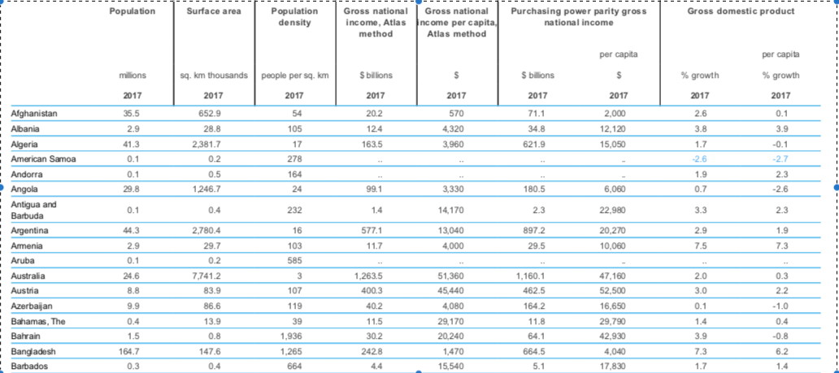
Breadth and Depth
Depth
Breadth
World Bank Development Indicators

Slide 31




Structure
Structured
Semi-structured
Unstructured

Slide 32
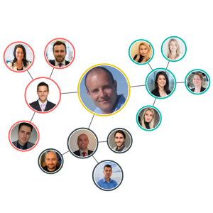
Graph Data
Graphs arise naturally in many settings
Many interesting techniques
e.g., Page Rank, community detection
Moz.com

Slide 33
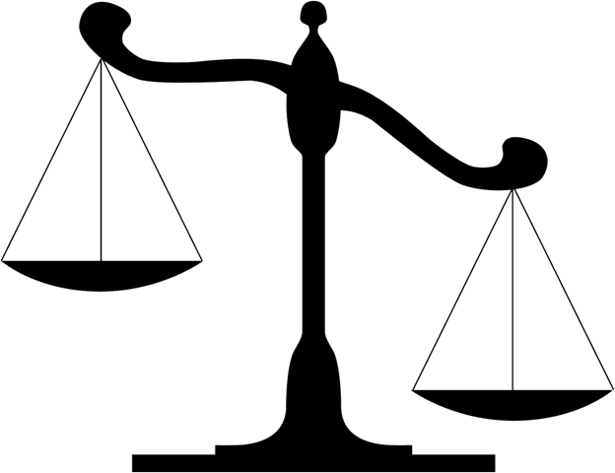
Data Quality
Errors
E.g., human labeling mistakes
Missing data
E.g., missing addresses in customer records
Bias
Sample bias, measurement bias, prejudice/stereotype

Slide 34
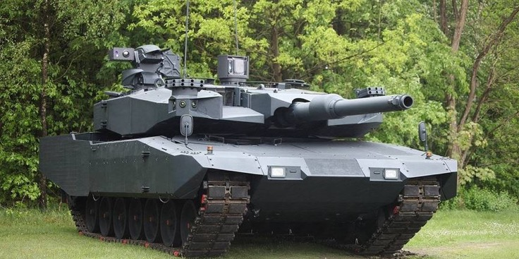
Data Quality: Sample Bias
Day Driving vs Night Driving
Tank recognition

Slide 35
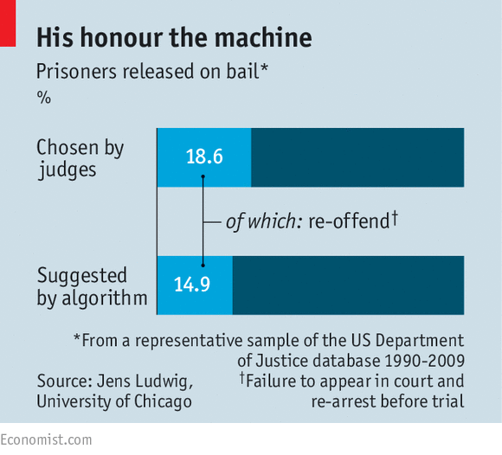
Data Quality: Prejudice/Stereotype Bias Algorithmic Law Enforcement
But what about perpetuating
bias against minorities?
The Economist, August 20, 2016

Slide 36

Data Quality: Measurement Bias

Slide 37
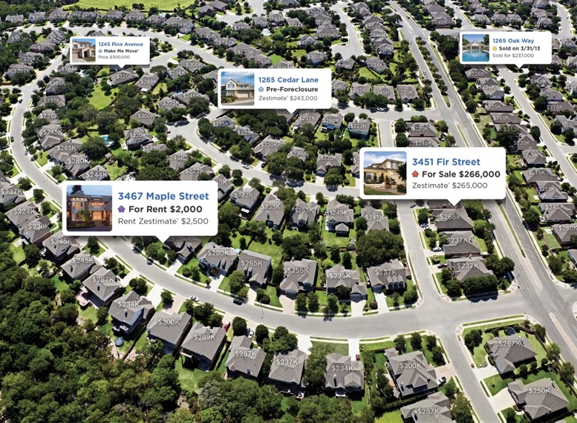
Data Freshness
Rate of data collection must match rate of change of underlying phenomenon

Slide 38
Data Cost
Cost includes several elements
Collection cost e.g., Mechanical Turk
Licensing costs e.g., real-time stock ticker
Data Cleaning and integration costs
Not a one-time cost but ongoing expense
Often 80% of the work and expense of the a machine-learning/AI project

Slide 39

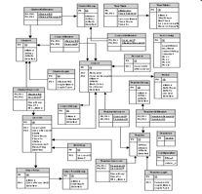
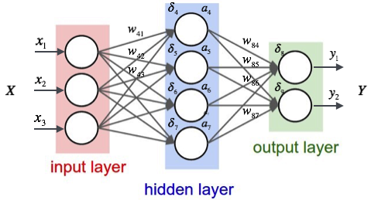
The Virtuous Cycle of Data Collection
Data
Product
Model
eriktrautman.com

Slide 40
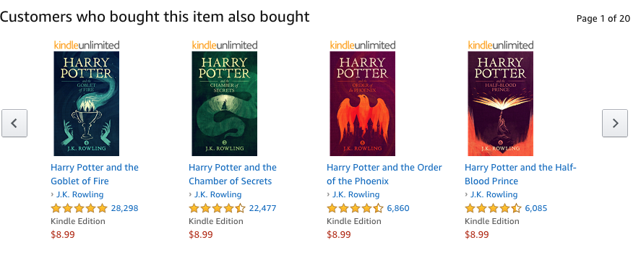
Explore/Exploit

Slide 41




Rocketship.vc: company data
How to tradeoff data sources based on Quantity, Quality, Structure, Freshness, and Cost?
Which subset of data sources yields the best model?
Which subset of data sources will identify promising companies most quickly?

